Slide 1
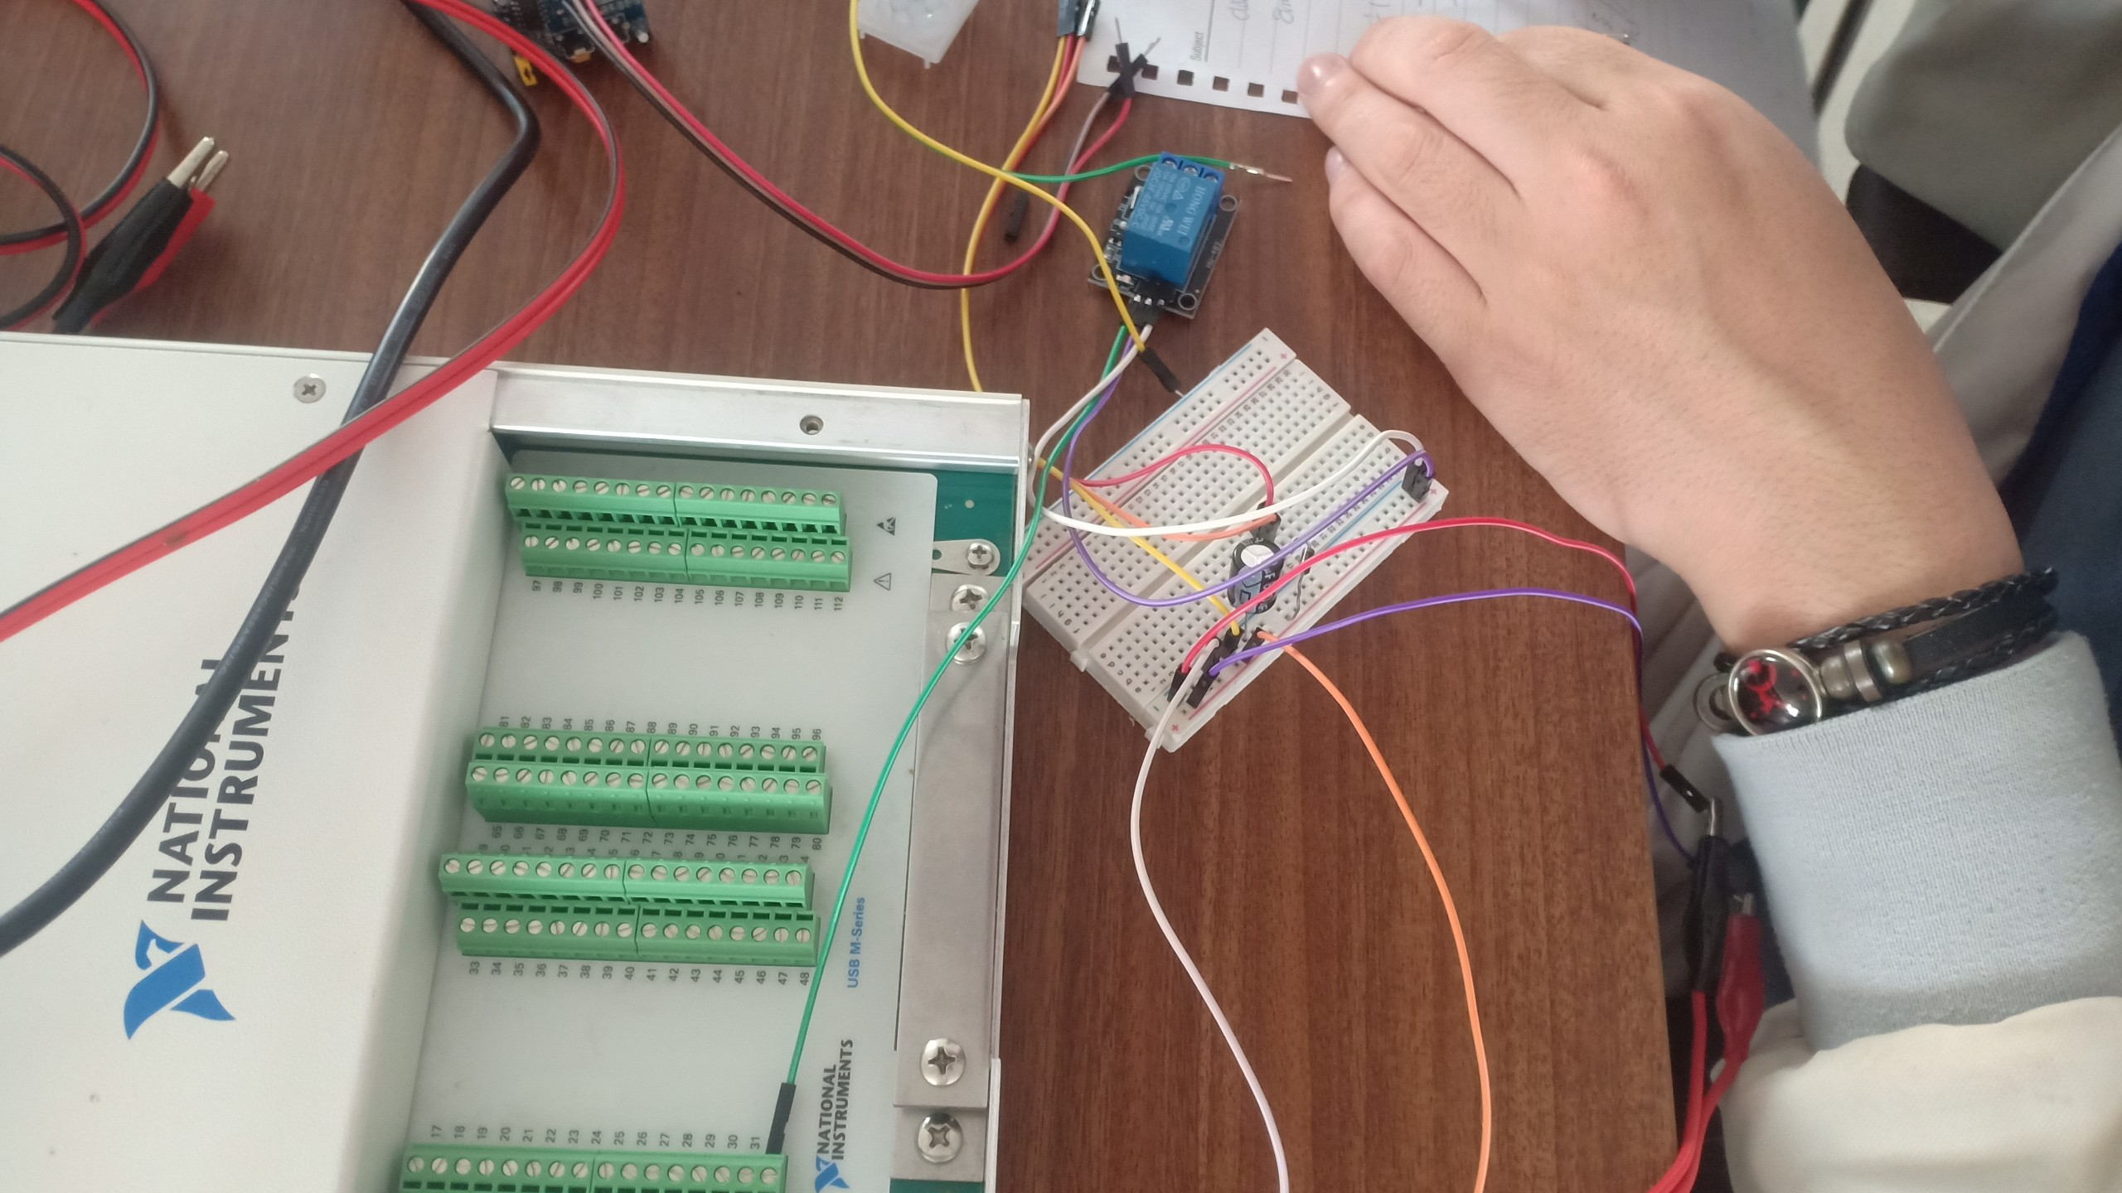
MIDTERM PROJECT Using passive Infrated sensor to Control Fan and Light (I.C.F.L)
DUONG DOAN TUNG
LE HOANG NAM
NGUYEN TRONG HUY HOANG
BASIC PROGRAMMING FOR ELECTRONIC

Slide 2
PIR sensor
USB-6255 Analog Input
Labview
USB-6255 Analog output
Fan, LED

